Slide 1
Download Arduino Library

Slide 2
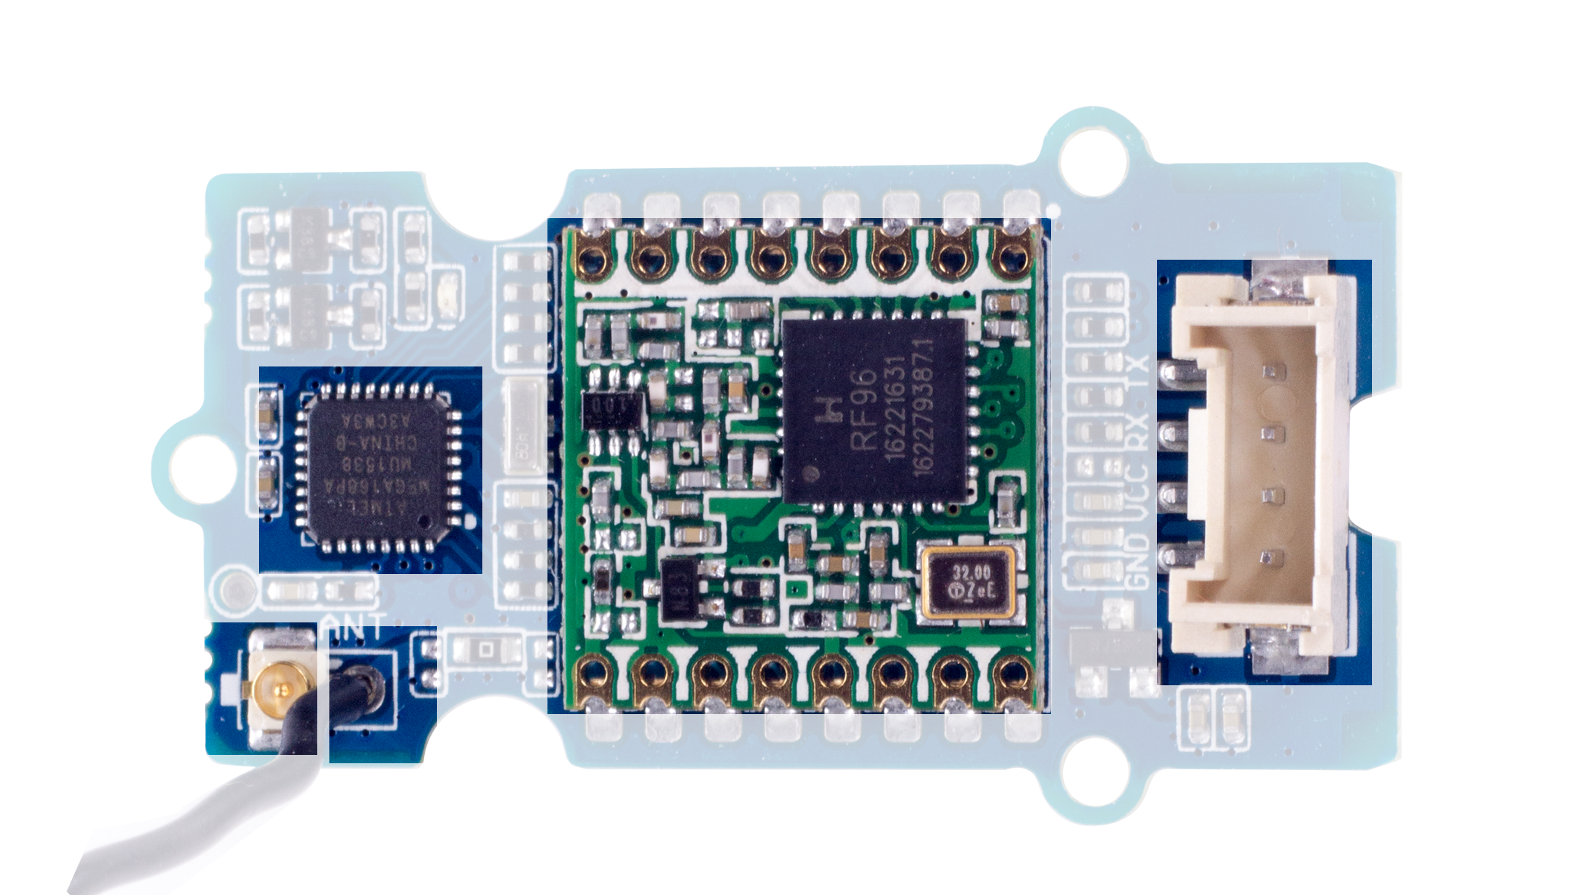
4
1
5
2
3

